Slide 1
Spring Wheat Crop Yield Prediction Model
CIND820: Capstone Project
Submitted by: Nadji Bessa
e./ nadji.bessa@torontomu.ca
Student Number: 944 363 324

Slide 2
Table of Contents
Objectives
Data Sources
Analysis
Challenges

Slide 3
Objectives

Slide 4
Objectives
Concerns over how climate change will impact farming, and with that our ability to continue to maintain adequate food supply, are the sponsoring thoughts behind this study.
The goal of this project was to determine quantifiable measures of how temperature and rainfall affecting crop production?

Slide 5
Objectives
There were two primary objectives with this project
Establish how temperature and precipitation can be used to determine crop yield
Determine if historical data can be used to infer future crop yield
Rather than examining all possible crops, Spring Wheat was selected for is vital inclusion in the production of a wide variety of foods.

Slide 6
Data Sources

Slide 7
Data Sources
Ontario Spring Wheat production data from 2004 to 2022, divided across counties:
https://data.ontario.ca/dataset/e30dc044-5f75-4f33-b63e-6326f8769bea/resource/16a875b9-5a56-4ad8-ac5b-dc77bde93c6d/download/ctyswheat.xlsx

Slide 8
Data Sources
Historical weather data from the Environment Canada’s network of weather stations:
https://climate.weather.gc.ca/historical_data/search_historic_data_e.html

Slide 9
Analysis

Slide 10
Analysis
There seems to be some correlation between temperature, precipitation and Spring Wheat yield, with precipitation having a higher correlation than temperature (as shown in the table below).
 | Yearly maximum temperature average (o Celsius) | Yearly total rain average (mm) | Yearly yield (bushels per acre)
Yearly maximum temperature average (o Celsius) | 1.000000 | 0.665556 | 0.019948
Yearly total rain average (mm) | 0.665556 | 1.000000 | -0.031880
Yearly yield (bushels per acre) | 0.019948 | -0.031880 | 1.000000
Notes:
Correlation data was calculated after aggregating daily weather data to yearly data and comparing it to yearly crop data…

Slide 11
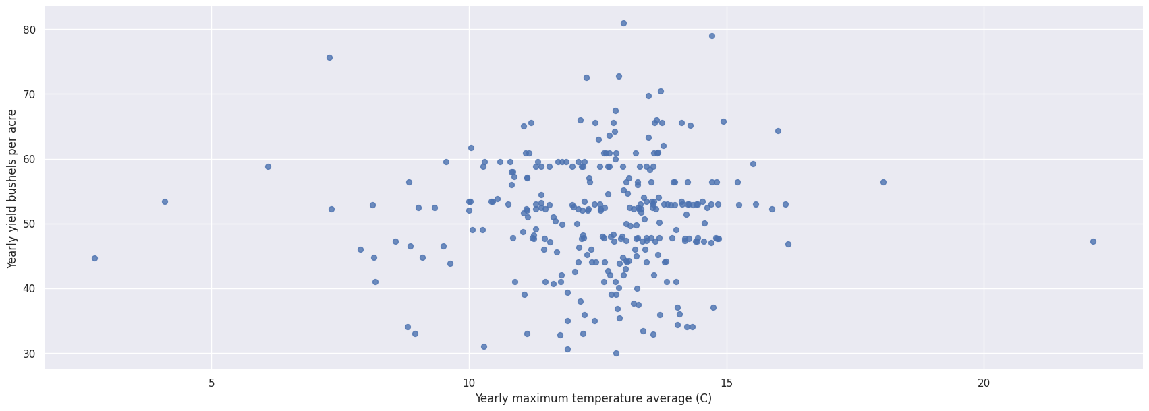
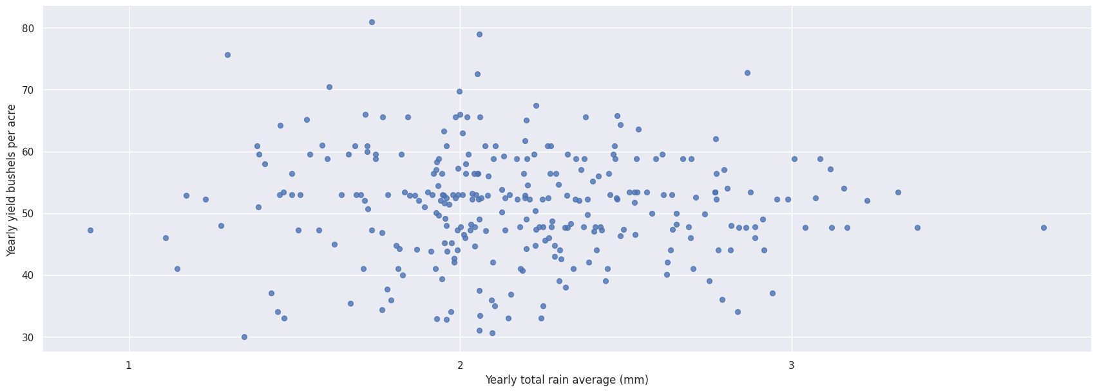
Analysis
There seems to be some linearity between temperature and crop yield (see diagram below, on the left) as well as between precipitation and crop yield (see diagram, below, on the right).
Thus, the conclusion can be established that temperature and precipitation are determinant in crop yield.
Notes:
Bear in mind that other determinants that have been established by biology such as sunlight exposure, soil composition, soil nutrient were not examined.

Slide 12
Analysis
A multivariate linear regression was selected as the analytic method which would be used to test the hypothesis that historical data can be used to determine future crop yield.
Due to limitation imposed by the availability of crop data, the validation of linear regression model, was limited to two folds:
2004 and 2005 data was used to predict 2006 results and validated by comparing against actual 2006 data
Similarly 2007 and 2008 data was used to predict 2009 results and validated by comparing against actual 2009 data

Slide 13
Analysis
The results were as follows: the RMSE for the year 2006 prediction was ~6.76 while for the year 2009 it was ~7.61.
From the above-mentioned results it can be derive that a Linear Regression can be used to predict future (Sprint Wheat) crop yield.
Please note that RMSE is the measure of the root of the mean of the squared errors between the predicted and observed/actual values. Please note that typically, a RMSE < 10% is considered excellent. 10% to 20% is considered good. Between 20% and 30% is considered to be fair and lastly a RMSE > 30%

Slide 14
Challenges

Slide 15
Challenges
Data Quality
Crop data was not consistent across counties throughout the period under study… perhaps because of the practice Crop rotation which advocates planting different crops sequentially on the same plot of land (to improve the health of the soil health, optimize nutrients in it, and combat pest and weed pressure).
This impacted the folds of data that were available to test the Linear Regression model

Slide 16
Challenges
Data Quality
There were very large gaps in weather data measurements which resulted in maximum temperature being selected as the measure of choice instead of minimum or mean temperature.
Perhaps in spring specially, with minimum temperature being an indicator of frost, it would have been better to use this measure instead since frost can have devastating consequence on crop growth.

Slide 17
Challenges
Operational
Accessibility of crop and weather data - finding and retrieving data from the sources used in this project was a definite challenge! Having a data warehousing platform onto which the data could be loaded and stored would have made easier to load the data necessary for the analysis

Slide 18
Questions?

